Slide 1
GASPA Human Capital Toolkit
Roadmaps for recruiting, selecting, and retaining highly effective teachers
May, 2014

Slide 2
Agenda
1
Toolkit Overview
Toolkit Walkthrough
Recruitment
Selection
Retention
Q&A
2
3

Slide 3
The Toolkit offers best practices and resources for improving human capital outcomes in three core HC areas
Toolkit Overview
Recruitment
Reaching and attracting candidates
Selection
Identifying and selecting the best
Retention
Retaining your top teachers

Slide 4
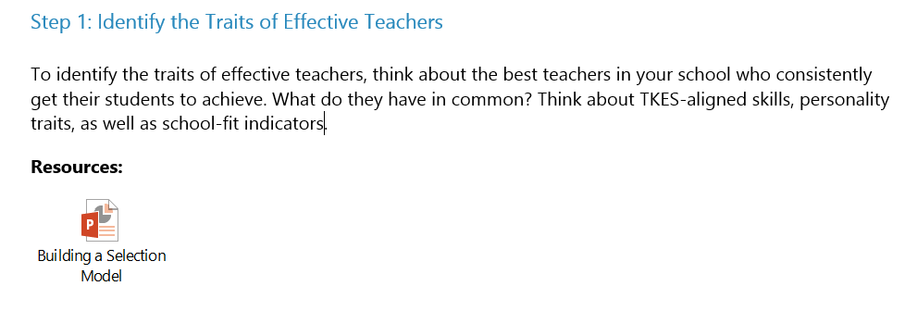
Each section is designed as a “roadmap” with step-by-step guidance and ready-to-use resources for that area of Human Capital management
Toolkit Overview

Slide 5
Simply follow the steps and use the resources as needed to improve your HC practices and outcomes
Toolkit Overview
Example:
Need interview questions for a stronger selection process? Follow the steps in the Selection Roadmap, then open the embedded TKES Question Bank for concrete interview questions you can use tomorrow.

Slide 6
Agenda
1
Toolkit Overview
Toolkit Walkthrough
Recruitment
Selection
Retention
Q&A
2
3

Slide 7
Toolkit Walkthrough
Toolkit Walkthrough
Recruit, Select and Retain Top Teachers

Recruitment Roadmap Recruit top talent, so you have the best pool of teachers to select from. | Selection Roadmap Select teachers who will be the best fit for your school. | Retention Roadmap Recognize and retain your top performers and best teachers.

Slide 8
Agenda
1
Toolkit Overview
Toolkit Walkthrough
Recruitment
Selection
Retention
Q&A
2
3

